Slide 1
iCoLoc: An Interactive System for Spatial
Co-location Pattern Mining via LLM-Guided
Intent and Contrastive Preference Learning
Xijia Ye, Xinran Xu, Jing Huang, Qi Han, Xuguang Bao
Guilin University of Electronic Technology
APWeb-WAIM 2026 · Da Nang, Vietnam · Session 34 (Special & Industrial Tracks)

Slide 2
Outline
2
• Background: Spatial Co-location Pattern Mining (SCPM)
• Motivation: limits of traditional interactive SCPM
• The iCoLoc idea: LLM intent + contrastive preference learning
• System architecture & pipeline
• Demonstration (Beijing POI benchmark, Web UI)
• Experimental evaluation: 0.80 -> 0.98 ranking accuracy
• Conclusion & future work

Slide 3
Background: What is SCPM?
3
• Spatial co-location patterns: sets of spatial features (e.g., POI categories) frequently located near each other
– Example: {Restaurant, Cafe, Cinema} often co-occur in commercial areas
• Classic mining uses a participation index (PI) threshold on neighbor relationships
• Used in retail site selection, urban planning, POI recommendation
• Traditional output: a large, static set of patterns - users must pick relevant ones themselves
Key gap: mining finds frequent patterns, not patterns the user actually wants.

Slide 4
Motivation: Pain Points
4
• Requires domain expertise: users must manually tune parameters and select patterns at the initial stage
• Fixed parameter settings -> thousands of irrelevant patterns
• Cannot adapt to dynamically changing user requirements within a session
• Fuzzy intent is hard to express in structured queries
• Non-expert analysts (retail screening, urban POI review) are left out
Goal: let non-experts mine spatial patterns via natural language + simple like/dislike feedback.

Slide 5
Key Idea: Re-rank without Re-mine
5
• LLM cold-start: a local LLM parses fuzzy natural-language intent -> initializes a user preference vector
• Mine once: a PI-based Join-Base miner generates the candidate set a single time
– Top-20 candidates ranked by cosine similarity to the user vector
• Binary feedback: user marks patterns as interesting / uninteresting
• Contrastive preference learning iteratively refines the user vector -> re-ranks the SAME candidates
– No re-mining, no parameter tuning - fast, stable, adaptive

Slide 6
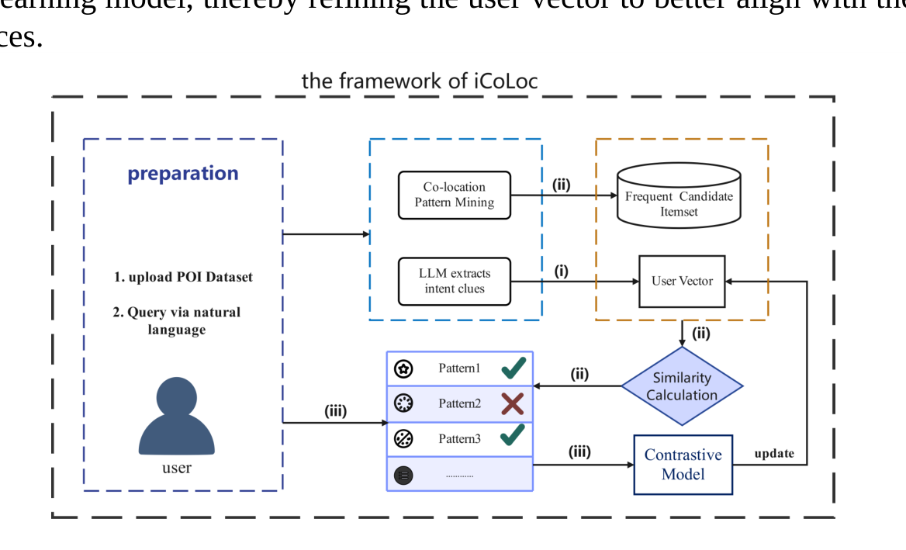
System Architecture (Fig. 1)
6
Intent-driven pipeline: LLM cold-starts the user vector; PI mining generates candidates once; feedback + contrastive learning re-ranks.

Slide 7
Step 1: LLM-Guided Intent Cold Start
7
• Users express fuzzy intent in natural language (no structured query, no parameter tuning)
• A local LLM interprets the query and extracts preferred feature categories
• Extracted preferences initialize the user representation vector
• Provides a reasonable starting ranking even before any feedback
– Enables zero-shot use by non-experts

Slide 8
Step 2: Candidate Generation (Mine Once)
8
• Join-Base algorithm enumerates frequent candidate itemsets from neighbor relationships
• Settings: participation index threshold = 0.6, maximum pattern size = 5
• Candidates ranked by cosine similarity with the user vector; top-20 shown for selection
• Candidate set is generated only once and reused in all later rounds

Slide 9
Step 3: Contrastive Preference Learning
9
• Each round, the user labels 5 patterns as interesting (positive) / uninteresting (negative)
• A contrastive learning model trains on these preference pairs
– Positive patterns pulled toward the user vector, negative ones pushed away
• User vector is progressively refined -> preference boundary sharpens
• Re-ranking uses the fixed candidate set - results improve without regenerating patterns

Slide 10
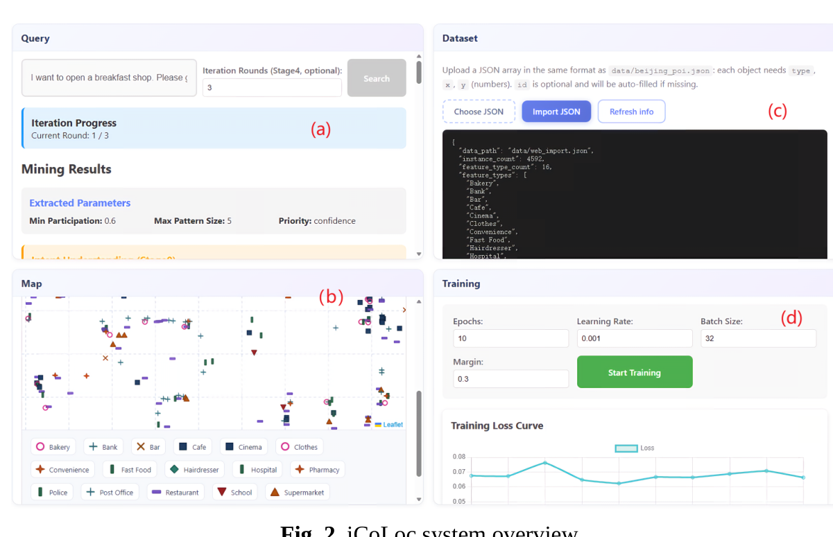
Demonstration: Web UI (Fig. 2)
10
• Beijing POI benchmark: 4,592 instances, 16 categories (Restaurant, Cafe, Cinema, Hospital ...)
• (a) Query & ranked results panel (b) spatial distribution map
• (c) dataset upload (uniform JSON: id, type, x, y) (d) training panel with loss curve
• Demo video: https://youtu.be/19WxxZbObKc

Slide 11
Experimental Setup
11
• Synthetic user who prefers patterns containing Restaurant
– Ground truth: relevant iff pattern includes a liked POI type and excludes all disliked types
• 10 feedback rounds driven by one fixed query; 5 patterns labeled per round
• Accuracy = fraction of mined patterns correctly classified (decision threshold 0.7)
• Three variants compared on identical data & mining settings:
– Baseline: iCoLoc without the contrastive learning component
– Feature-weighted: 2025 personalized ROI recommendation method
– Contrastive: full iCoLoc

Slide 12
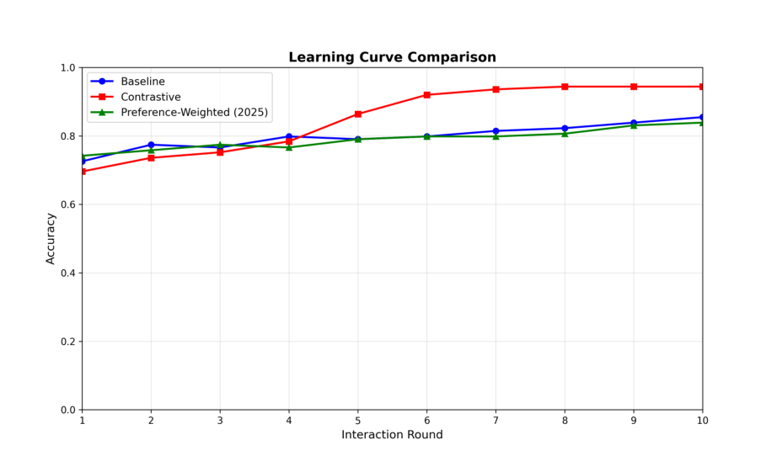
Results: Feedback-Driven Improvement (Fig. 3)
12
0.80 Baseline (final round)
0.86 Feature-weighted (2025)
0.98 iCoLoc contrastive (ours)
The contrastive model starts low but climbs rapidly as feedback accumulates; baselines plateau.

Slide 13
Conclusion & Future Work
13
• iCoLoc = LLM intent parsing + contrastive preference learning for interactive SCPM
• Non-experts mine spatial patterns via fuzzy natural language and like/dislike feedback
• Re-ranking-without-re-mining makes interaction fast and stable
• 0.80 -> 0.98 ranking accuracy after feedback accumulates
• Future: richer LLM reasoning, larger datasets, real-world deployment

Slide 14
Thank you!
Questions & Discussion
Xijia Ye · Guilin University of Electronic Technology
Demo: https://youtu.be/19WxxZbObKc

